Slide 1
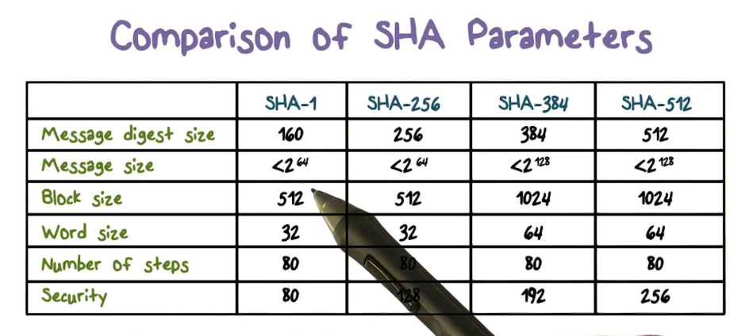
Secure Hash Algorithms
SHA2, SHA3, RIPEMD, BLAKE, …

Slide 2
Secure Cryptographic Hash Functions
Old hash algorithms: MD5, SHA-0, SHA-1
Withdrawn due to cryptographic weaknesses (collisions found)
SHA-2
Family of functions: SHA-256 (256 bits hash), SHA-512 (512 bits), …
SHA-3
More secure, same hash length (256 bits), known as "Keccak"
RIPEMD-160
Secure hash function, widely used in cryptography, e.g. PGP, Bitcoin
Less secure variations: RIPEMD-128, RIPEMD-256, RIPEMD-320

Slide 3
Secure Cryptographic Hash Functions (2)
BLAKE / BLAKE2 / BLAKE2s / BLAKE2b
Fast, secure cryptographic hash function
256-bit (BLAKE-256, BLAKE2s) and 512-bit (BLAKE-512, BLAKE2b)
As of Mar 2018, no collisions are known for:
SHA256, SHA3-256, Keccak-256, BLAKE2s, RIPEMD160
Brute forcing to find collision costs: 2¹²⁸ for SHA256/SHA3-256 and 2⁸⁰ for RIPEMD160 (2^{256/3} / 2^{160/3} on quantum computer)
* Learn more at: https://z.cash/technology/history-of-hash-function-attacks.html

Slide 4
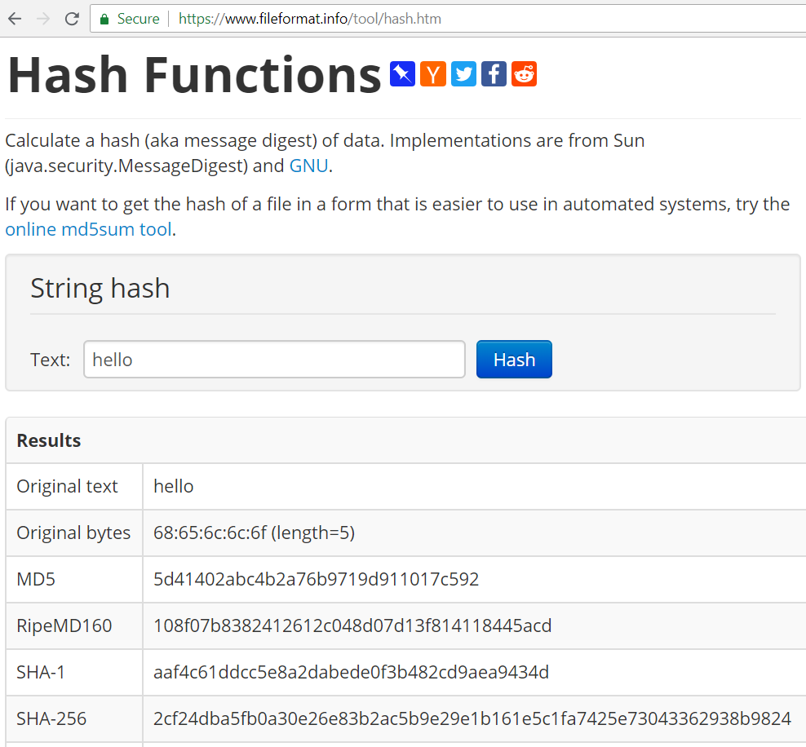
Live Demo
Playing with Hash Functions Online
https://www.fileformat.info/tool/hash.htm

Slide 5

Secure Hash Algorithms: SHA2, SHA3, RIPEMD, BLAKE, …
Try the Demo!

